Slide 1
Encoder-decoder model
Biplab Banerjee

Slide 2
Deep CNN based image segmentation
Auto-encoder
Regularized auto-encoder
Class-encoder
Image segmentation

Slide 3
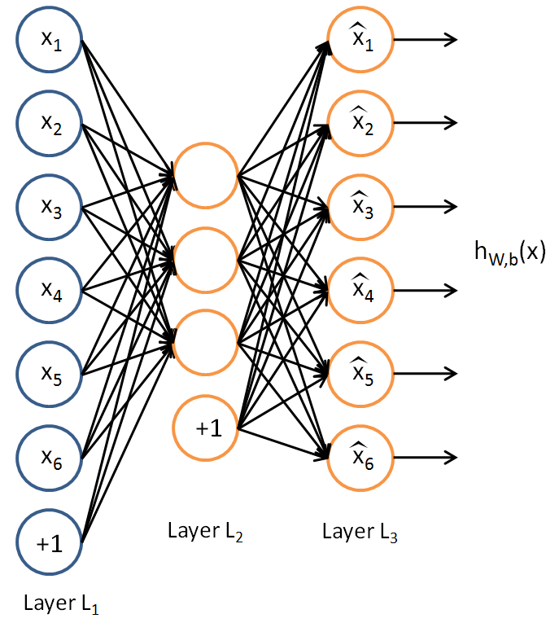

Traditional Autoencoder
$$z$$

Slide 4

Traditional Autoencoder
Unlike the PCA now we can use activation functions to achieve non-linearity.
It has been shown that an AE without activation functions achieves the PCA capacity. (later)
$$z$$

Slide 5
Uses
The autoencoder idea was a part of NN history for decades (LeCun et al, 1987).
Traditionally an autoencoder is used for dimensionality reduction and feature learning.
Representation learning

Slide 6
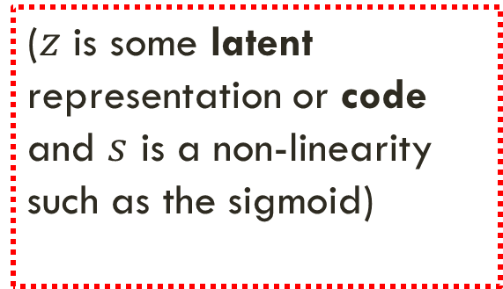
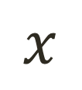
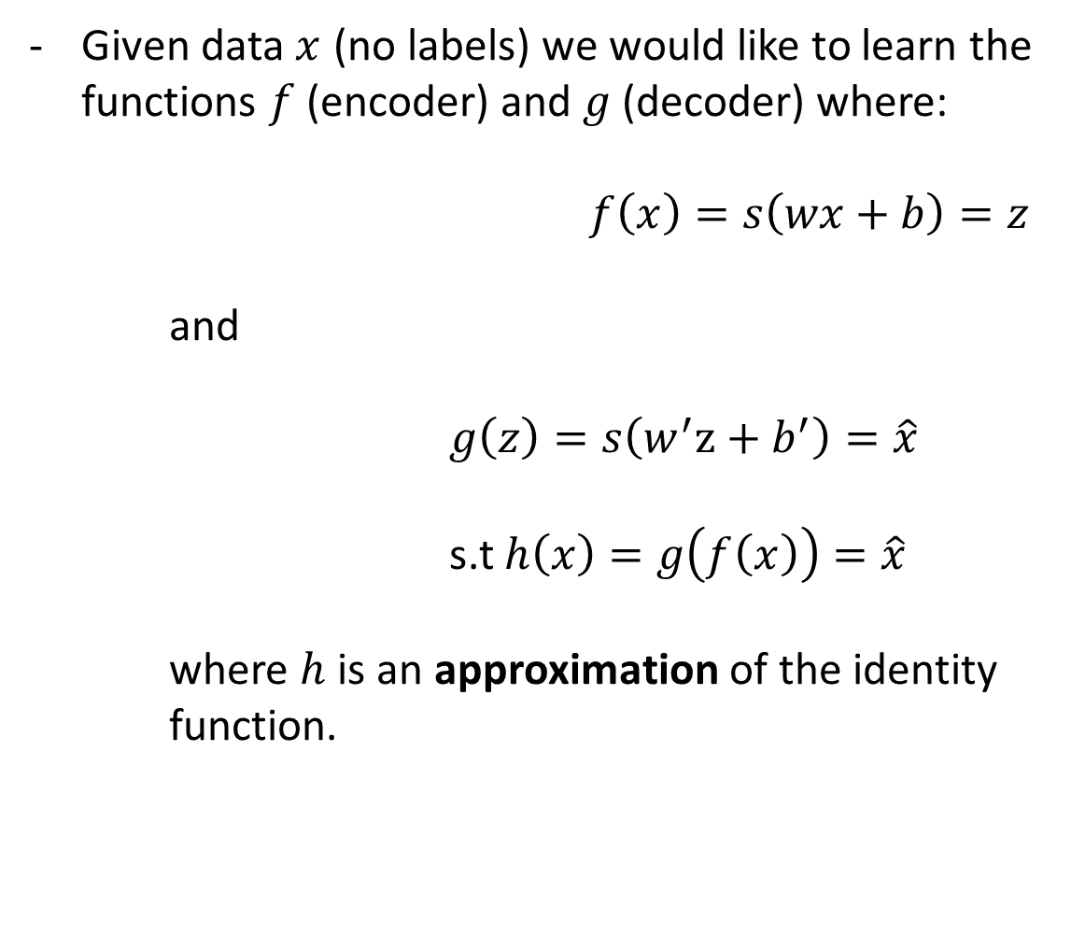
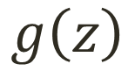
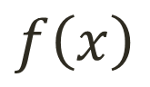

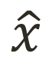
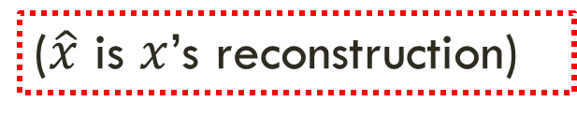
Simple Idea
Given data $x$ (no labels) we would like to learn the functions $f$ (encoder) and $g$(decoder) where:
$f\left(x\right)=s\left(wx+b\right)=z$
and
$g\left(z\right)=s\left(w^{′}z+b^{′}\right)=\hat{x}$
s.t $h\left(x\right)=g\left(f\left(x\right)\right)=\hat{x}$
where $h$ is an approximation of the identity function.
$$x$$
$$f\left(x\right)$$
$$z$$
$$g\left(z\right)$$
$$\hat{x}$$
($z$ is some latent representation or code and $s$ is a non-linearity such as the sigmoid)
($\hat{x}$ is $x$’s reconstruction)

Slide 7
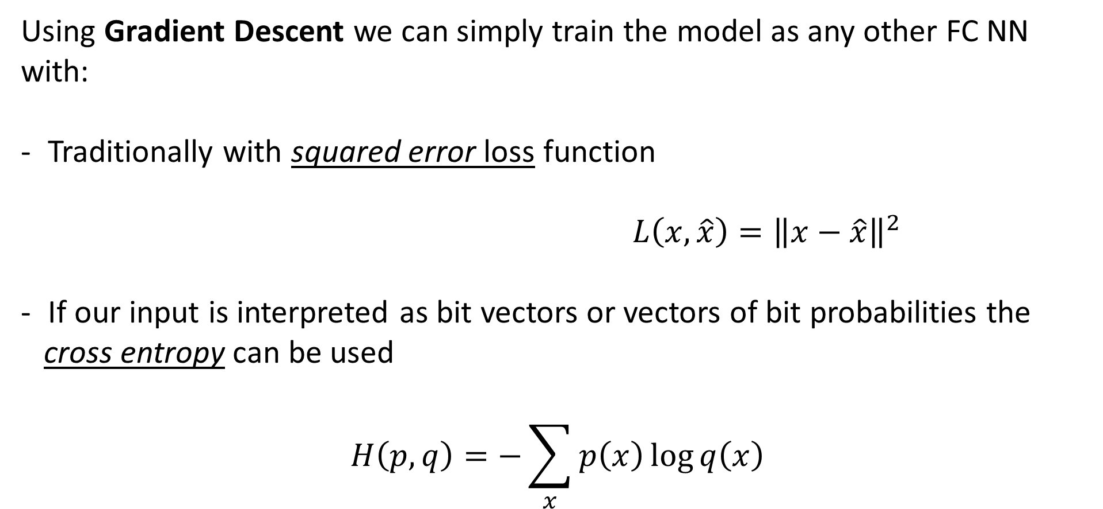
Training the AE
Using Gradient Descent we can simply train the model as any other FC NN with:
Traditionally with squared error loss function
$L\left(x,\hat{x}\right)={\left\|x−\hat{x}\right\|}^{2}$
If our input is interpreted as bit vectors or vectors of bit probabilities the
cross entropy can be used
$$H\left(p,q\right)=−\sum_{x}{p\left(x\right)\log{q\left(x\right)}}$$

Slide 8
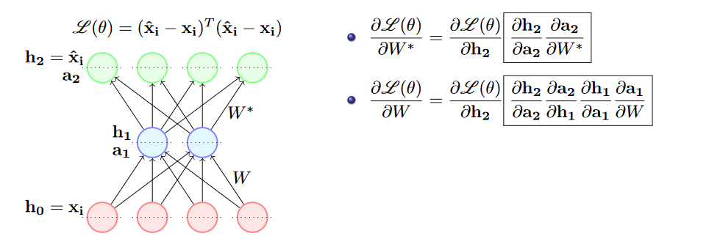

Slide 9
Undercomplete AE VS overcomplete AE
We distinguish between two types of AE structures:

Slide 10
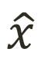
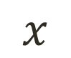
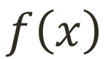


Undercomplete AE
Hidden layer is Undercomplete if smaller than the input layer
Compresses the input
Compresses well only for the training dist.
$$\hat{x}$$
$$w′$$
$$f\left(x\right)$$
Hidden nodes will be
Good features for the training distribution.
Bad for other types on input
$$w$$
$$x$$

Slide 11
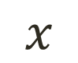
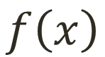
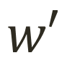

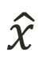
Overcomplete AE
Hidden layer is Overcomplete if greater than the input layer
No compression in hidden layer.
Each hidden unit could copy a different input component.
$$\hat{x}$$
$$w′$$
$$f\left(x\right)$$
$$w$$
No guarantee that the hidden units will extract meaningful structure.
$$x$$

Slide 12
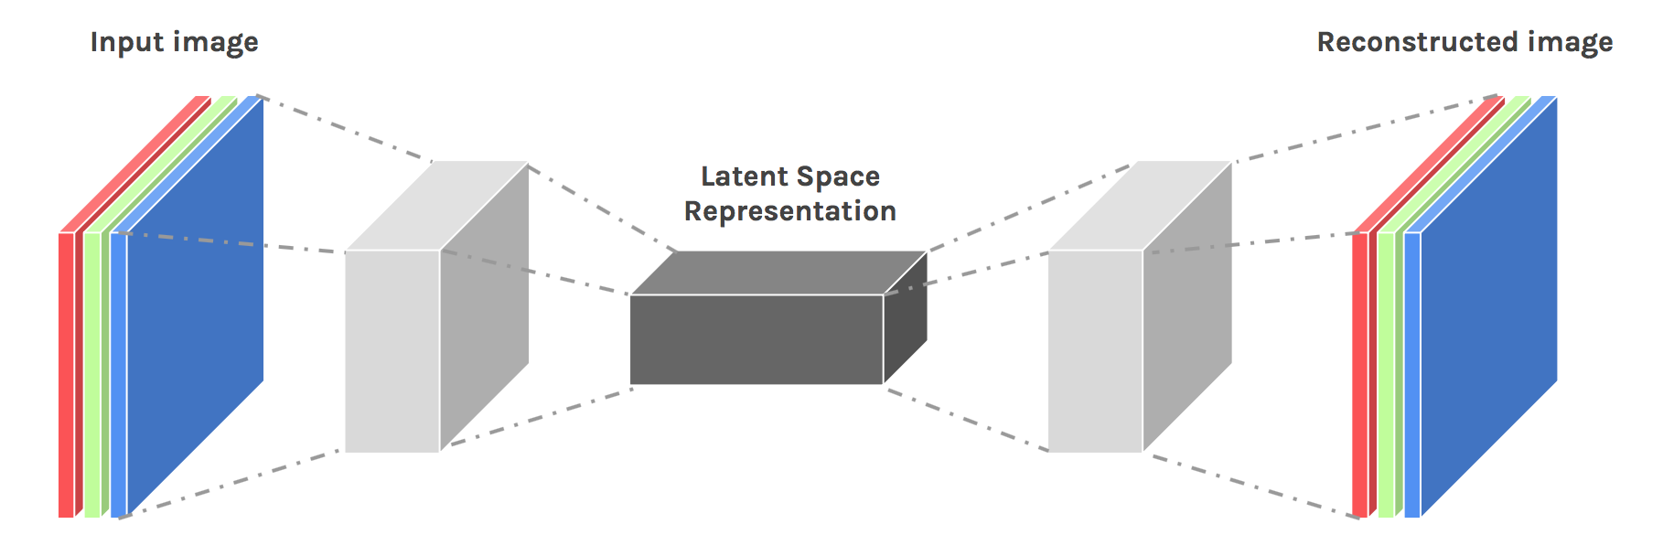
Convolutional AE

Slide 13
Convolutional AE
* Input values are normalized
* All of the conv layers activation functions are relu except for the last conv which is sigm
Output
Input
(28,28,1)
C1
(28,28,16)
M.P1
(14,14,16)
C2
(14,14,8)
M.P2
(7,7,8)
C3
(7,7,8)
M.P3
(4,4,8)
D.C1
(4,4,8)
U.S1
(8,8,8)
D.C2
(8,8,8)
U.S2
(16,16,8)
D.C3
(14,14,16)
U.S3
(28,28,8)
D.C4
(28,28,1)
Conv 1
16 F
@ (3,3,1)
same
M.P 1
(2,2)
same
Conv 2
8 F
@ (3,3,16)
same
M.P 2
(2,2)
same
Conv 3
8 F
@ (3,3,8)
same
M.P 3
(2,2)
same
D Conv 1
8 F
@ (3,3,8)
same
U.S 1
(2,2)
D Conv 2
8 F
@ (3,3,8)
same
U.S 2
(2,2)
D Conv 3
16 F
@ (3,3,8)
valid
U.S 3
(2,2)
D Conv 4
1 F
@ (5,5,8)
same
Hidden Code
Encoder
Decoder

Slide 14
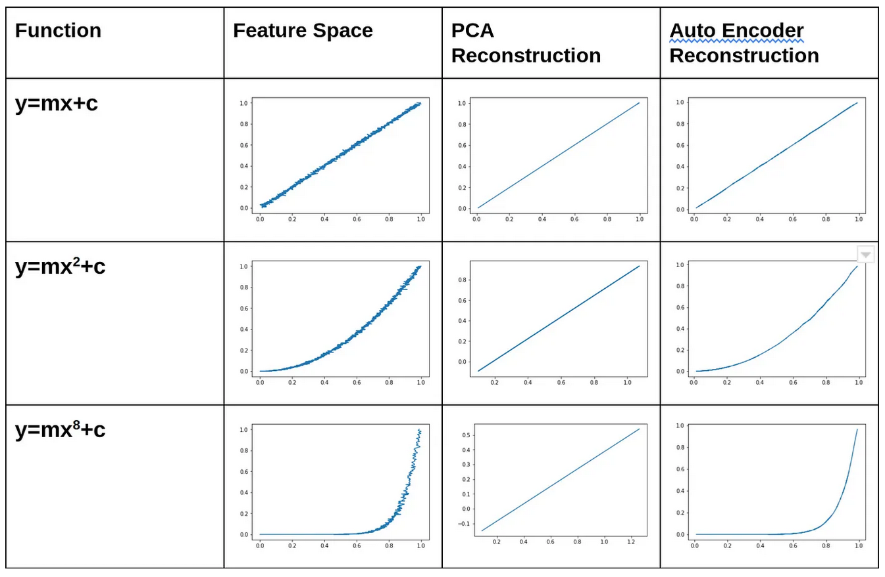
AE vs PCA

Slide 15
Differences between AE and PCA
Linearity vs. Non-Linearity: PCA is a linear technique, whereas Autoencoders can learn non-linear representations of data.
Interpretability vs. Deep Learning: PCA’s principal components are interpretable as they are linear combinations of the original variables. Autoencoder results can be less interpretable due to the complexity of the neural network.
Supervision: PCA is an unsupervised technique, while Autoencoders can be used in both unsupervised and supervised settings.
Flexibility: Autoencoders offer greater flexibility in capturing complex, non-linear relationships in data compared to the linear combinations of PCA.

Slide 16
Regularization
Motivation:
We would like to learn meaningful features without altering the code’s dimensions (Overcomplete or Undercomplete).
The solution: imposing other constraints on the network.

Slide 17
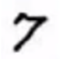
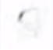

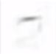
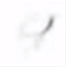


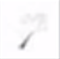

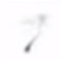
Sparsely Regulated Autoencoders
We want our learned features to be as sparse as possible.
With sparse features we can generalize better.
= 1*
+ 1*
+ 1*
+ 1*
+ 1*
+ 1*
+ 1*
+ 0.8*
+ 0.8*

Slide 18
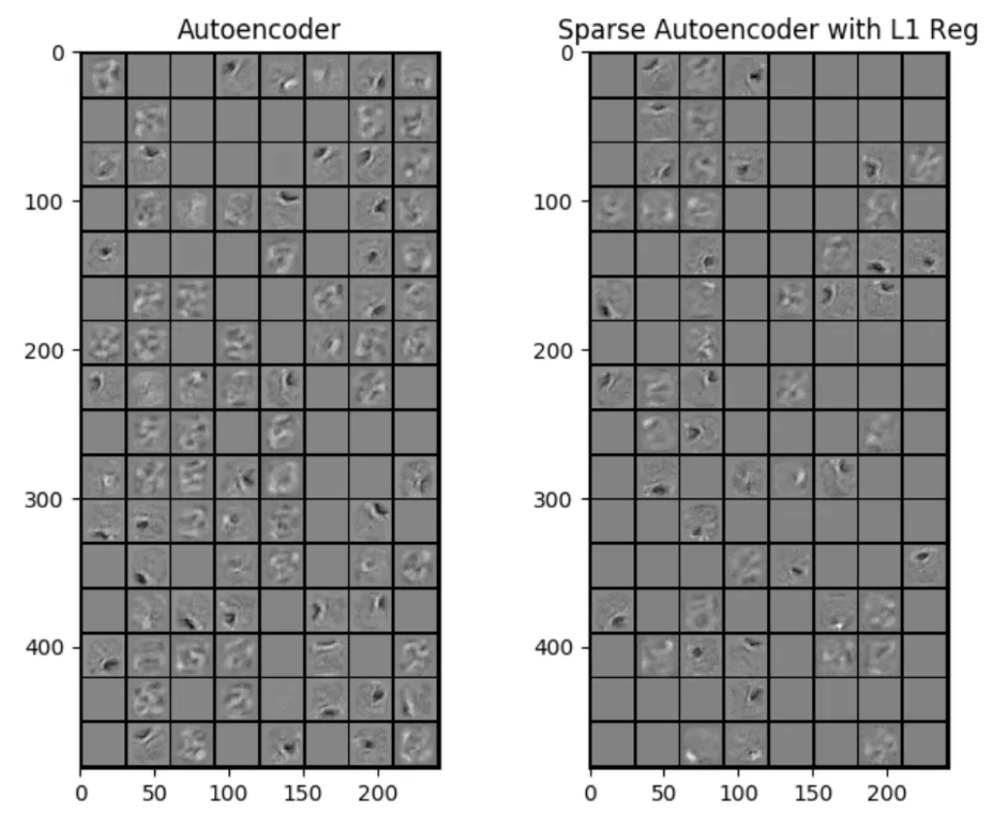

Slide 19
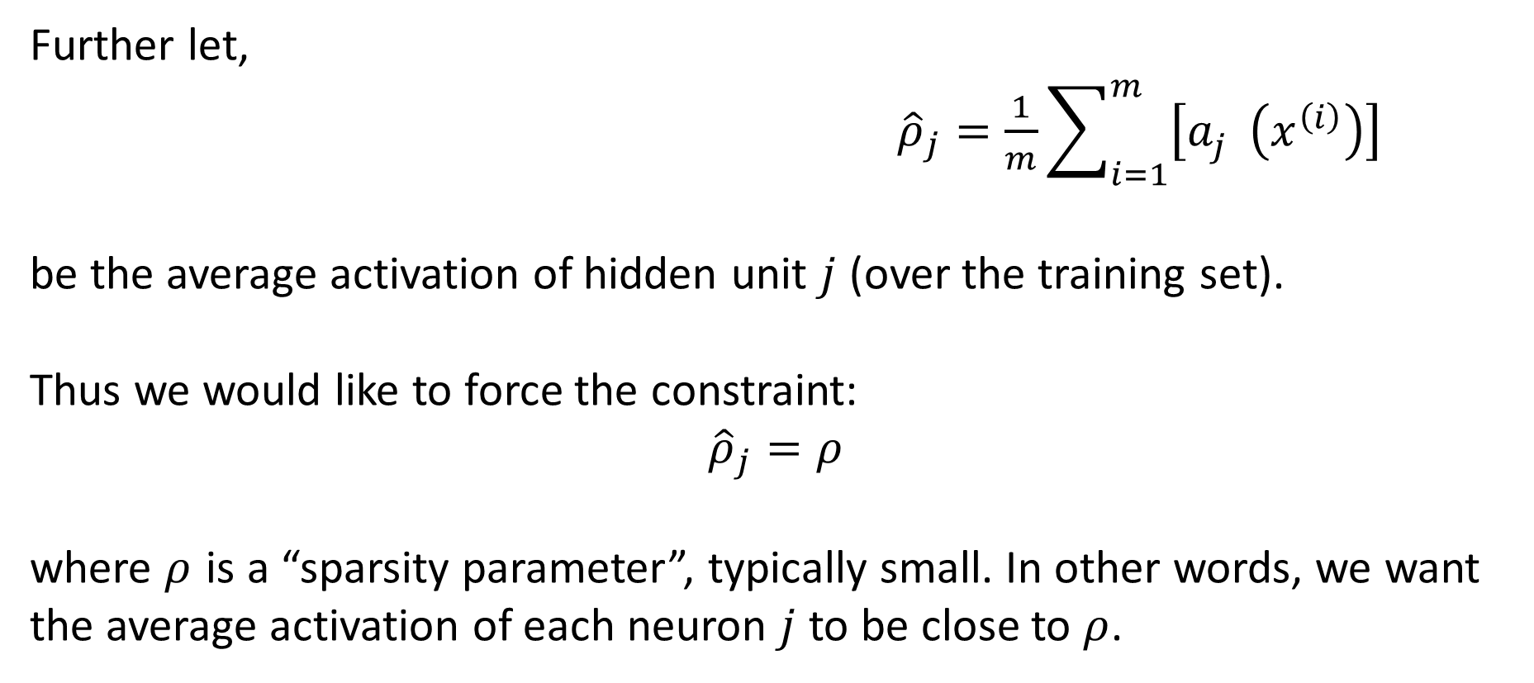
Sparsely Regulated Autoencoders
Further let,
${\hat{ρ}}_{j}=\frac{1}{m}\sum_{i=1}^{m}{\left[a_{j}^{}\left(x^{\left(i\right)}\right)\right]}$
be the average activation of hidden unit $j$ (over the training set).
Thus we would like to force the constraint:
$${\hat{ρ}}_{j}=ρ$$
where $ρ$ is a “sparsity parameter”, typically small. In other words, we want the average activation of each neuron $j$ to be close to $ρ$.

Slide 20
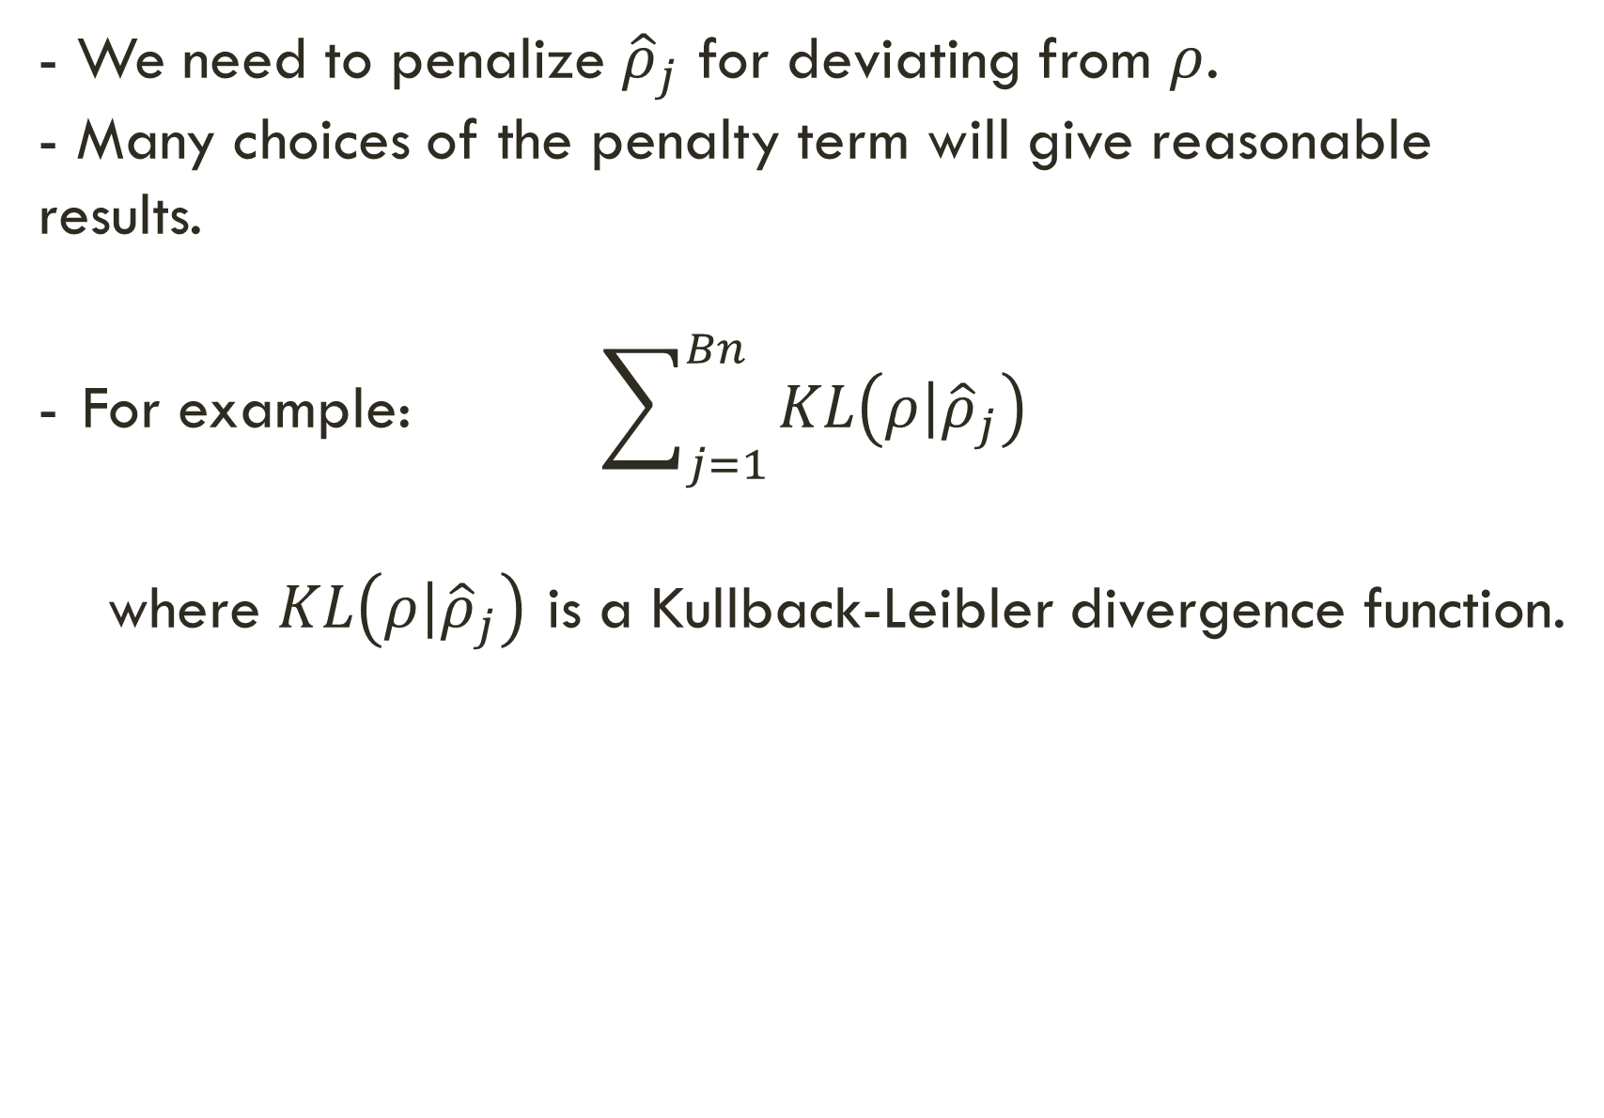
Sparsely Regulated Autoencoders
- We need to penalize ${\hat{ρ}}_{j}$ for deviating from $ρ$.
- Many choices of the penalty term will give reasonable results.
For example: $\sum_{j=1}^{Bn}{KL\left(\left.ρ\right|{\hat{ρ}}_{j}\right)}$
where $KL\left(\left.ρ\right|{\hat{ρ}}_{j}\right)$ is a Kullback-Leibler divergence function.

Slide 21
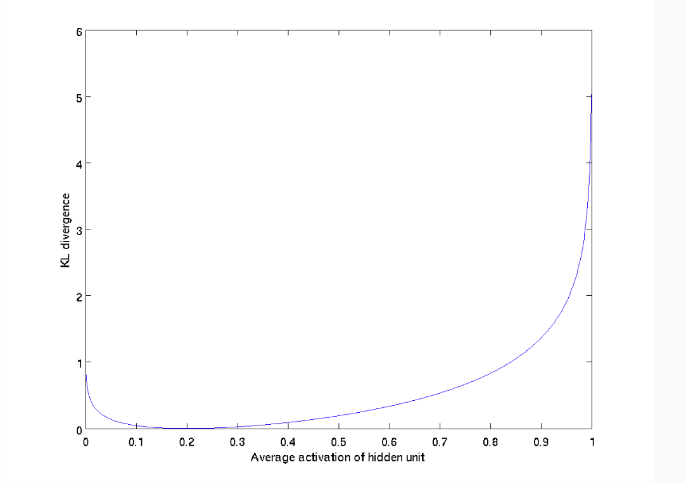
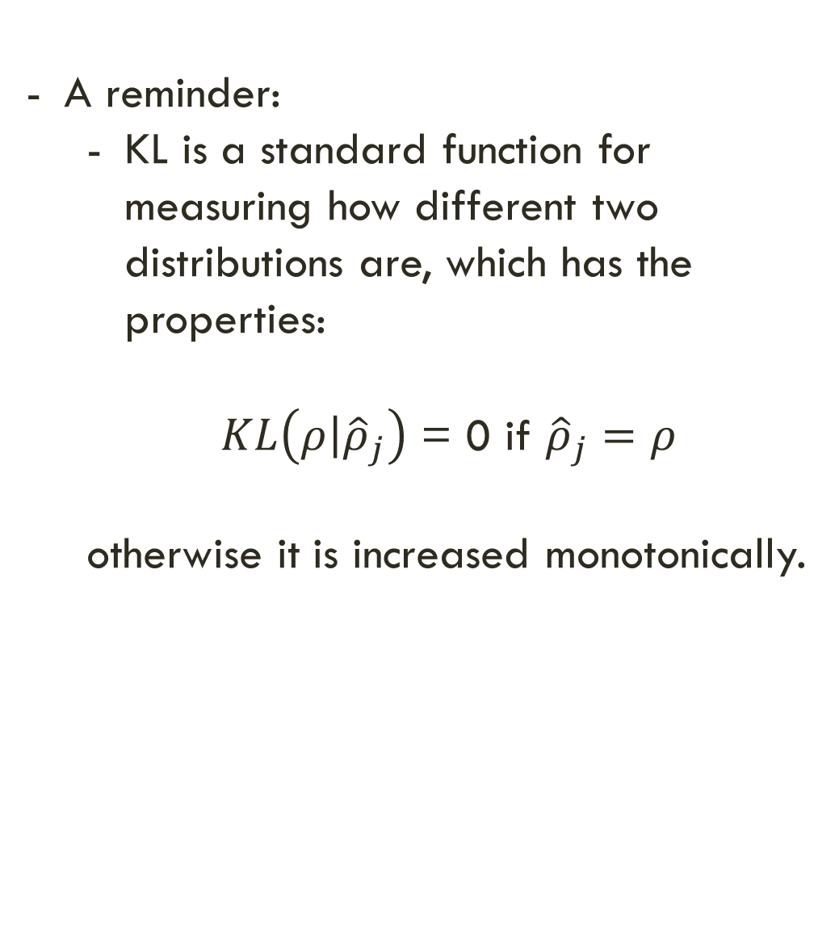
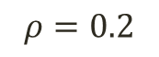
Sparsely Regulated Autoencoders
A reminder:
KL is a standard function for measuring how different two distributions are, which has the properties:
$KL\left(\left.ρ\right|{\hat{ρ}}_{j}\right)$ = 0 if ${\hat{ρ}}_{j}=ρ$
otherwise it is increased monotonically.
$$ρ=0.2$$

Slide 22
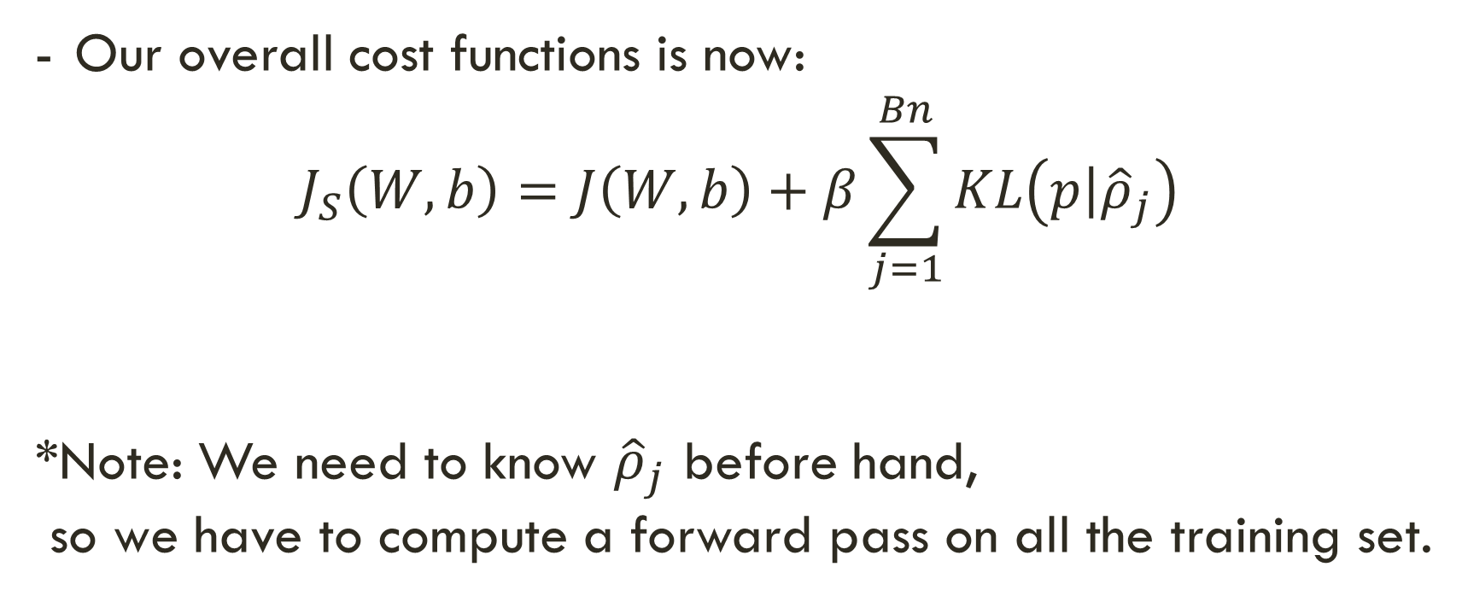
Sparsely Regulated Autoencoders
Our overall cost functions is now:
$$J_{S}\left(W,b\right)=J\left(W,b\right)+β\sum_{j=1}^{Bn}{KL\left(\left.p\right|{\hat{ρ}}_{j}\right)}$$
*Note: We need to know ${\hat{ρ}}_{j}$ before hand,
so we have to compute a forward pass on all the training set.

Slide 23

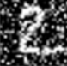

Denoising Autoencoders
Intuition:
We still aim to encode the input and to NOT mimic the identity function.
We try to undo the effect of corruption process stochastically applied to the input.
A more robust model
Encoder
Decoder
Noisy Input
Denoised Input
Latent space representation

Slide 24
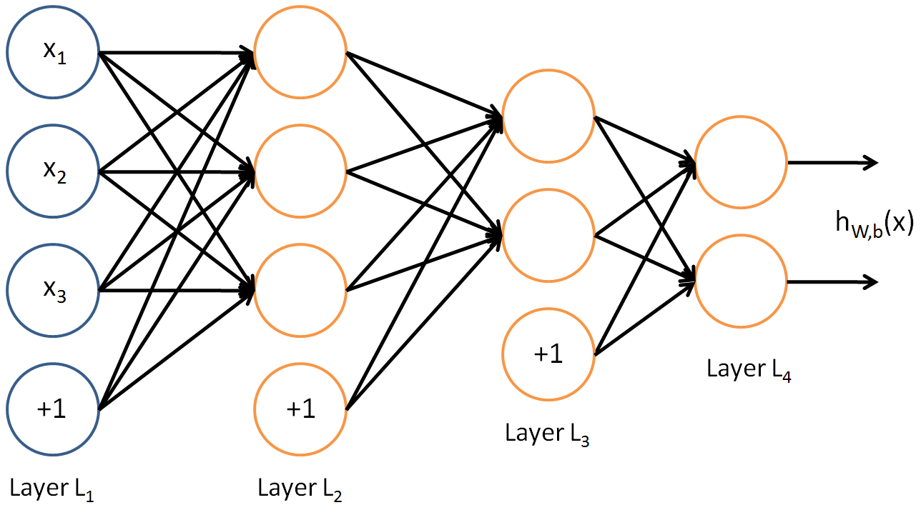
Denoising Autoencoders
Use Case:
Extract robust representation for a NN classifier.
Encoder
Noisy Input
Latent space representation

Slide 25
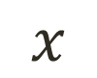



Contractive autoencoders
$$\hat{x}$$
We wish to extract features that only reflect variations observed in the training set. We would like to be invariant to the other variations.
- Points close to each other in the input space should maintain that property in the latent space.
$$w′$$
$$w$$
$$x$$

Slide 26
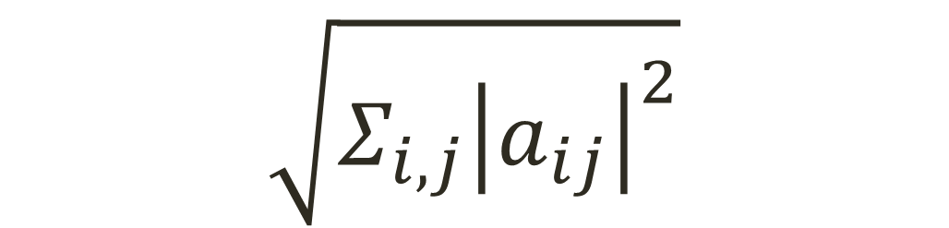
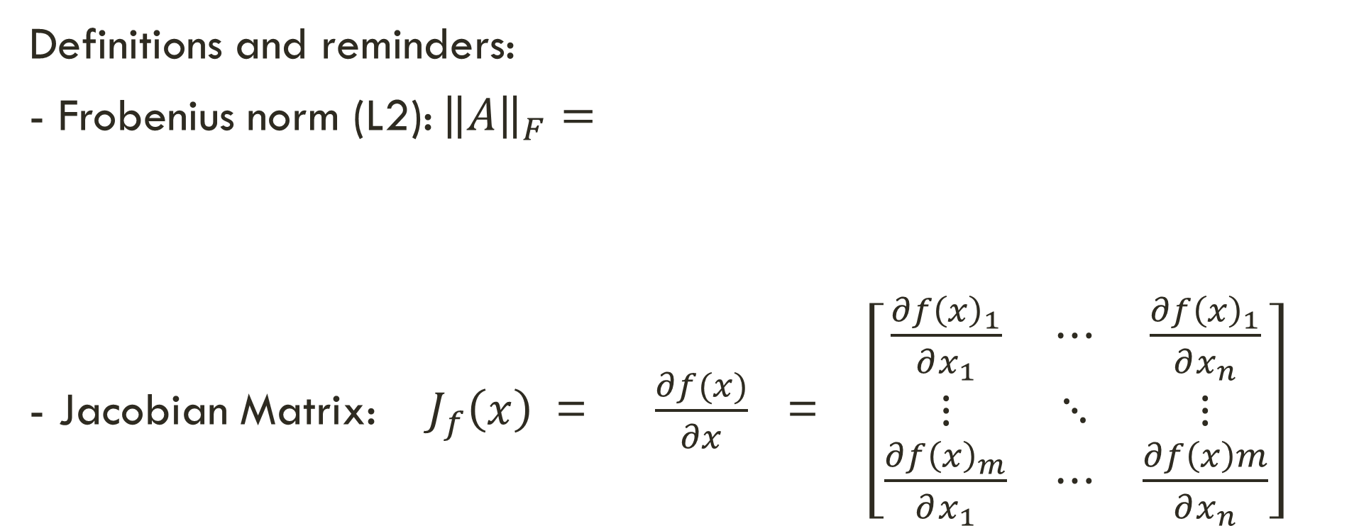
Contractive autoencoders
Definitions and reminders:
- Frobenius norm (L2): ${\left\|A\right\|}_{F}=$
- Jacobian Matrix: $J_{f}\left(x\right)$ = $\frac{∂f(x)}{∂x}$ = $\left[\begin{matrix}\frac{∂f{\left(x\right)}_{1}}{∂x_{1}} & ⋯ & \frac{∂f{\left(x\right)}_{1}}{∂x_{n}} \\ ⋮ & ⋱ & ⋮ \\ \frac{∂f{\left(x\right)}_{m}}{∂x_{1}} & ⋯ & \frac{∂f\left(x\right)m}{∂x_{n}}\end{matrix}\right]$
$$\sqrt{Σ_{i,j}{\left|a_{ij}\right|}^{2}}$$

Slide 27
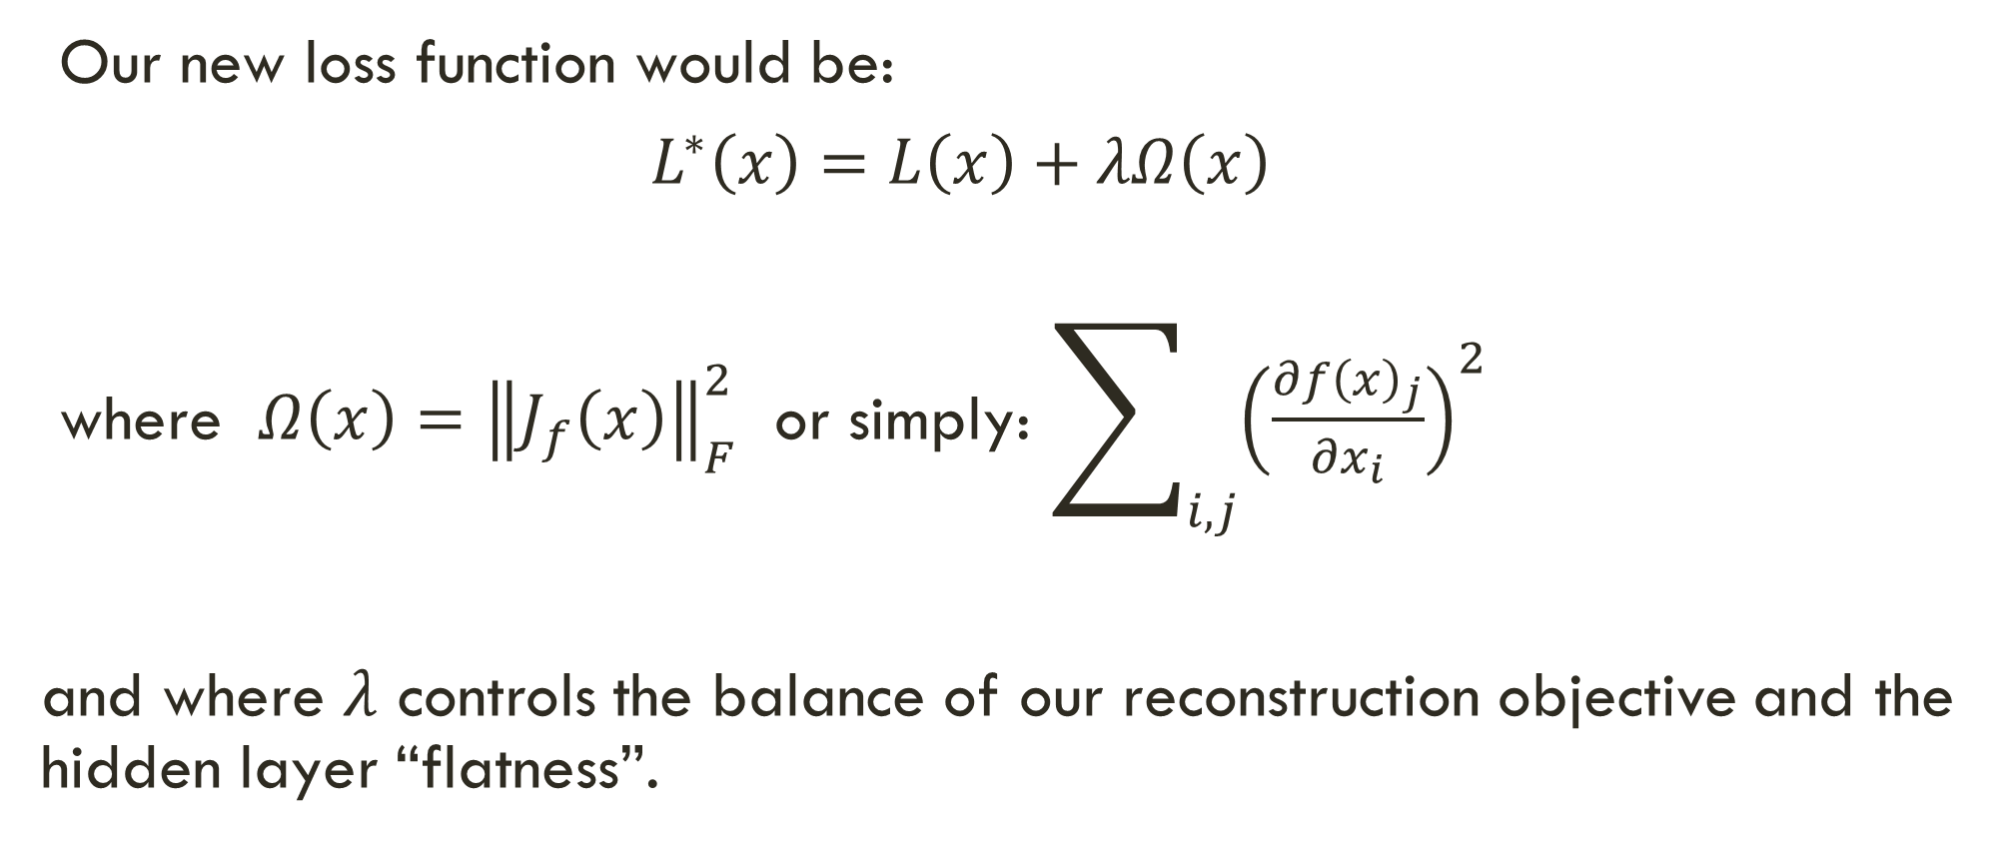
Contractive autoencoders
Our new loss function would be:
$L^{∗}\left(x\right)=L\left(x\right)+λΩ\left(x\right)$
where $Ω\left(x\right)={\left\|J_{f}\left(x\right)\right\|}_{F}^{2}$ or simply: $\sum_{i,j}{{\left(\frac{∂f{\left(x\right)}_{j}}{∂x_{i}}\right)}^{2}}$
and where $λ$ controls the balance of our reconstruction objective and the hidden layer “flatness”.

Slide 28
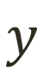
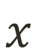
Stacked AE
SAE
Classifier
$$x$$
$$y$$

Slide 29
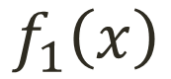
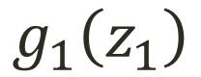
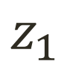
Stacked AE – train process
First Layer Training (AE 1)
$$x$$
$$f_{1}\left(x\right)$$
$$z_{1}$$
$$g_{1}\left(z_{1}\right)$$
$$\hat{x}$$

Slide 30
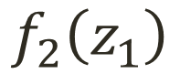
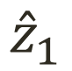
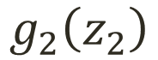
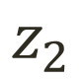
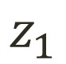
Stacked AE – train process
Second Layer Training (AE 2)
$$x$$
$$f_{1}\left(x\right)$$
$$z_{1}$$
$$f_{2}\left(z_{1}\right)$$
$$z_{2}$$
$$g_{2}\left(z_{2}\right)$$
$${\hat{z}}_{1}$$

Slide 31
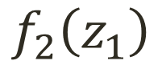
Stacked AE – train process
Add any classifier
Classifier
$$x$$
$$f_{1}\left(x\right)$$
$$z_{1}$$
$$f_{2}\left(z_{1}\right)$$
$$z_{2}$$
Output

Slide 32
Class encoder
Define an autoencoder for each class
Cross sample reconstruction for each class
Can we put some constraint in the encoder space to ensure non-redundancy in the latent features?

Slide 33
The Task
person
grass
trees
motorbike
road

Slide 34
Evaluation metric
Pixel classification!
Accuracy?
Heavily unbalanced
Common classes are over-emphasized
Intersection over Union
Average across classes and images
Per-class accuracy
Compute accuracy for every class and then average

Slide 35
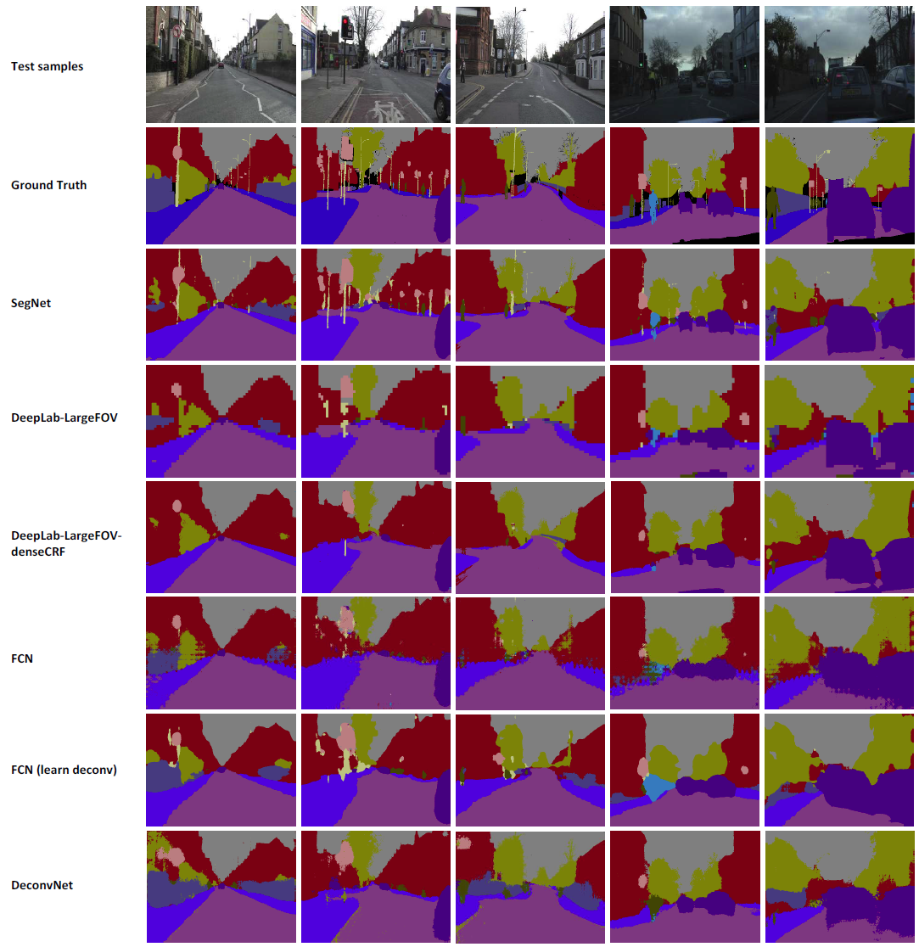

Slide 36


Slide 37
Things vs Stuff
THINGS
Person, cat, horse, etc
Constrained shape
Individual instances with separate identity
May need to look at objects
STUFF
Road, grass, sky etc
Amorphous, no shape
No notion of instances
Can be done at pixel level
“texture”

Slide 38
Semantic segmentation using convolutional networks
c
#classes
Convolve with #classes 1x1 filters
w/4
h/4

Slide 39
The resolution issue
Problem: Need fine details!
Shallower network / earlier layers?
Deeper networks work better: more abstract concepts
Shallower network => Not very semantic!
Remove subsampling?
Subsampling allows later layers to capture larger and larger patterns
Without subsampling => Looks at only a small window!

Slide 40



Image pyramids
Higher resolution Less context
Small networks that maintain resolution
Learning Hierarchical Features for Scene Labeling. Clement Farabet, Camille Couprie, Laurent Najman, Yann LeCun. In TPAMI, 2013.

Slide 41

Image segmentation FCN

Slide 42


Image segmentation - segnet

Slide 43

Image segmentation U-net

Slide 44

PSPNet (Pyramid scene parsing)

Slide 45

Deeplab

Slide 46


Slide 47

Instance segmentation

